Slide 1
EASTASN - , EE - , EALC – 402A
Topics in International Technology Management
Week 1: September 17, 2020
Understanding Digital Transformation in Asia
Richard B. Dasher, Ph.D.
Director, US-Asia Technology Management Center
Adjunct Professor, Stanford University

Slide 2
Welcome to everyone
Stanford students may take the series for University credit
Register for EASTASN-402A, EE-402A, or EALC-402A
One unit, S/NC
See Syllabus for requirement for credit (differs from other seminars)
Weekly comment by email to me that provides evidence you watched the session
Each comment is due within two weeks of the date of that session
Autumn 2020 University deadline for completion of all work: November 20, 2020
But I am granting extension for last comment (on 11/19 session) to December 1, 2020
Public is welcome
Continuing long history of US-ATMC mixed audiences: Silicon Valley and Stanford
Please register for the entire series at https://stanford.zoom.us/meeting/register/tJIldu6srDsjG9yX-9Mhl6v2VCtCcBUhSLYo
Time of official class: 4:30 pm – 5:50 pm
The session is being recorded and will be posted to the Internet
Optional networking session (not recorded): 5:50 pm – 6:30 pm

Slide 3
Outline
Digital transformation: response to an industrial revolution
Defining digital transformation (DX)
The impact of COVID-19
The progress of DX in Asia and the US
Teaser: subsequent sessions of this series

Slide 4
We are in the midst of two overlapping Industrial Revolutions
First Industrial Revolution (IR): Advent of machines (mechanization) |  | mid-late 1700’s – mid-late 1800’s | New tools, equipment, manufacturing processes (& lifestyles)
Second IR: New ways of using machines: mass manufacturing |  | mid 1800’s – mid 1900’s | Assembly lines, standardized parts > specialized salaried jobs > urbanization
Third IR: digital ICT becomes ubiquitous | Mainframe-terminal | 1940’s – c. 1980 | Structured text > unstructured text > image/audio > IOT
 | Client-server | c. 1980 – c. 2005
 | Cloud | c. 2005 - present
Fourth IR: New ways of capturing value from data | Industry 4.0 (transitional from 3-IR) | c. 2010 - present | Artificial intelligence, blockchain, edge computing, quantum computing, ...
 | More analytics and automation

Slide 5
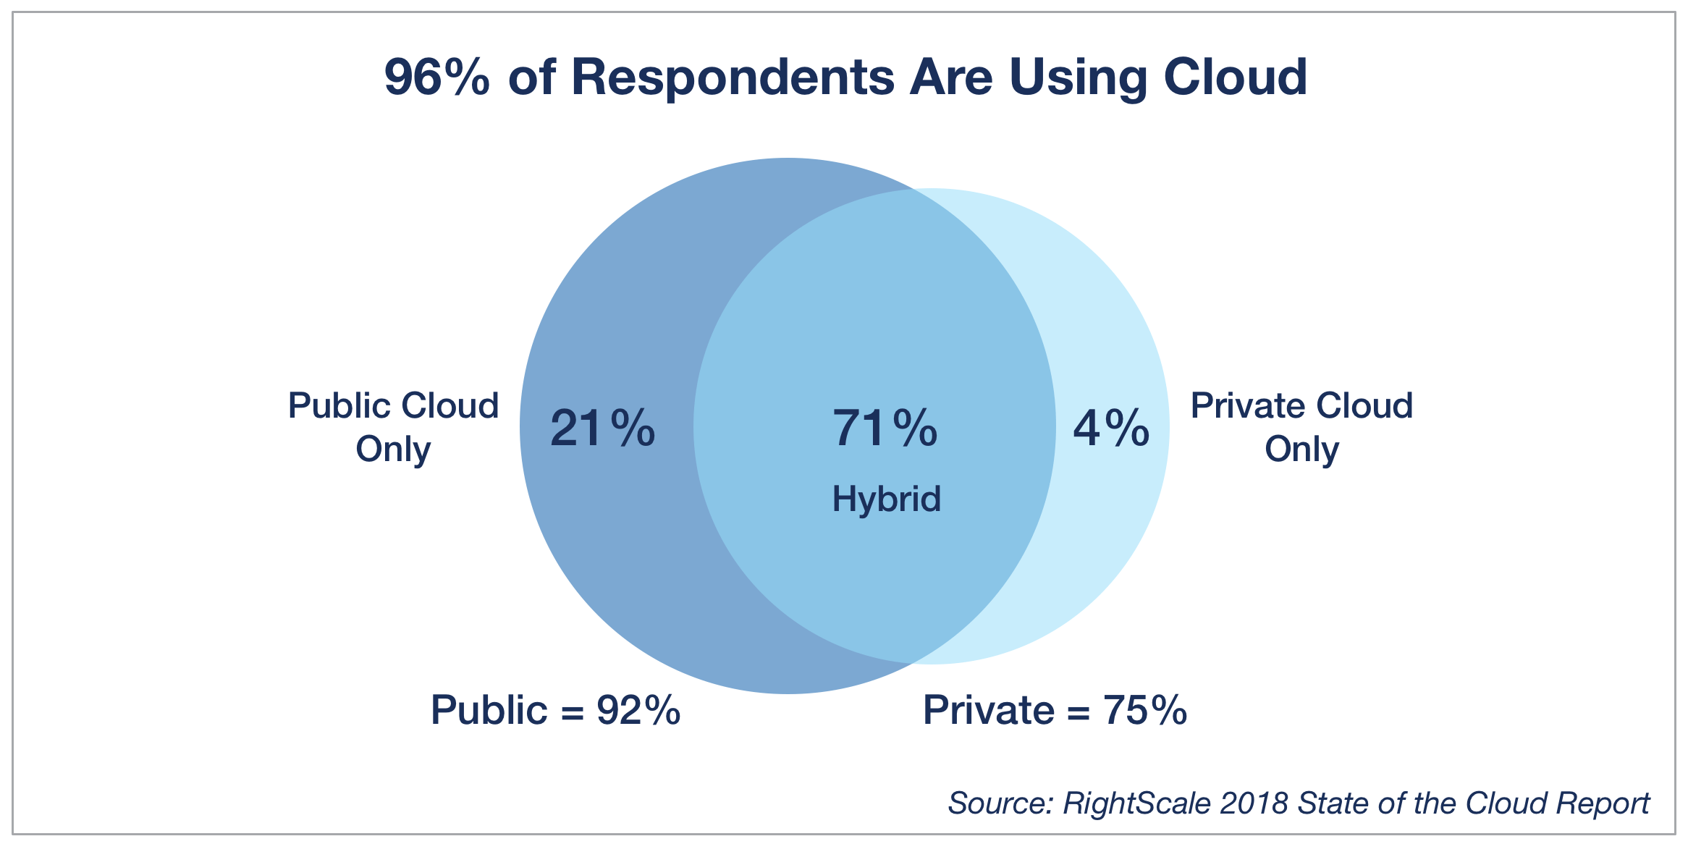
3-IR: By 2018, Cloud Computing is already ubiquitous
Up from 72% in 2016
(January 2018 survey of 997 IT professionals, of whom 53% represented organizations of 1,000 or more employees)

Slide 6
4-IR: AI adoption in selected industries (2019)
Percentage of respondents, by selected industry, who reported 1-or-more AI programs in at least one product or business process for 1-or-more functions or business units
• Of 2,360 respondents in all industries, 1,872 work at companies that fit this category
McKinsey, Nov. 2019, Global AI Survey

Slide 7
Industrial revolutions and digital transformation
What happens in an industrial revolution? Macro-scale change
New ways of doing things in industry become mainstream
New lifestyles become the norm
Polarization of winners and losers
Companies and people “on the side of innovation” tend to increase in wealth
Economic gap widens to those left behind
Results in 19th-century: migrations to the New World, social unrest, reactionary politics
Results in 21st-century: national populism, anti-immigration sentiment, etc.
Digital transformation: Micro-economic response
Individual companies undergo change at their core
Adopting the new standards is essential to stay ”alive” (competitive)

Slide 8
Digitalization = adoption of digital techs and tools
Digital encoding of data
3-IR
Data transfer (communications)
Storage
Processing
4-IR New tools
• Artificial intelligence
• Edge computing
• Blockchain
• Quantum computing
• …
Adoption
= (only) the beginning of transformation

Slide 9
Digital transformation: using digital data to change core aspects of business
Digital adoption | Digital transformation
Cloud computing | Cloud-first IT architecture
(Big) data analytics | Data-driven business • New customer experiences • Internal performance evaluation
Online advertising | Real-time bidding, influencer marketing
IT in cars & factories | Autonomous vehicles, ridesharing, intelligent robots, smart factories, predictive maintenance scheduling …
E-commerce (online sales) | Crowdsourcing, price optimization, value-driven pricing
Chatbots for communications | Alexa (controls things), robot process automation
Online payment, financial svcs | Data-driven banking & insurance, risk optimization

Slide 10
Adoption versus transformation
Basic distinction: an additive process versus a change of core
Change of core: give up old way in order to shift focus to new way
Much value can be created by adoption
Consider Google’s revenues from online advertising
But, Google’s online advertising had transformative impact on industry
Took revenue from traditional print and broadcast advertising
Shift to online advertising was classic case of “disruptive innovation”
Google = new entrant, did not have to give up anything
(Additive) adoption is easy; transformation of existing firm is hard
Must recognize impending change in some core process or relationship
Must develop capabilities and incentives to give up the old and adopt the new
… or be disrupted by some outsider new entrant

Slide 11
DX expected to create great value
Word Economic Forum estimate:
• Total $100 trillion to world economy (2016-2025)
• Over $12 trillion to four industries shown at right
• Also estimated related value to society
• E.g. automotive:
Value to industry (efficiency through new sales channels) = $0.7T
Value to society (cost savings, reduced crash costs, lower insurance premiums, fewer injuries, lower carbon emissions) = $3.1T
Sources: World Economic Forum, Accenture <http://reports.weforum.org/digital-transformation/identifying-value-at-stake-for-society-and-industry/>, accessed 9/16/2020

Slide 12
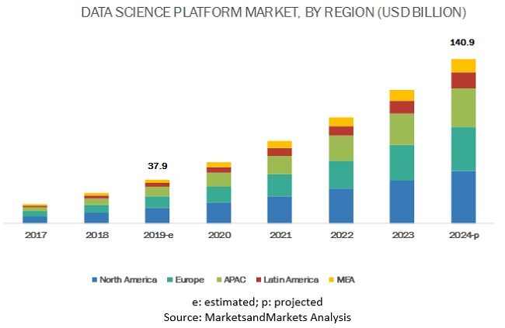
Add to that: transformation-enablers: New job types and new industries
Job title | Median salary | Job openings
1. Front end engineer | $105,240 | 13,122
2. Java developer | 83,589 | 16,136
3. Data scientist | 107,801 | 6,542
4. Product manager | 117,713 | 12,173
5. DevOps engineer | 107,310 | 6,603
6. Data engineer | 102,472 | 6,941
7. Software engineer | 105,563 | 50,438
Includes: business lines of IBM, Microsoft (Azure), etc., data prep (e.g. DataIku), MLOps (Databrick) autoML (e.g. DataRobot) etc.,
= 30.0% CAGR
<https://www.marketsandmarkets.com/Market-Reports/data-science-platform-market-21532997.html>, accessed 9/16/2020
From GlassDoor, 50 Best Jobs in U.S. 2020

Slide 13
COVID-19 has mostly accelerated / amplified IR changes already in progress
Digital transformation: enabled new patterns of work, business
Shift from possible new way of doing things to must-have capability
Internet-based videoconferencing essential to work-from-home
Shopping-from-home moved to mainstream (even among older people)
Cloud-first IT architecture: necessary for distributed teamwork, online document signing, etc.
Increased inequality: also a feature of industrial revolutions
Winning industries (e.g. videoconferencing, cloud services) versus losing industries (e.g. travel & hospitality, traditional retail)
Digital divide (correlates with wealth gap)
Secure jobs versus precarious jobs
COVID-19 revealed need for greater resilience
Global supply chain strategies were already threatened by U.S. – China tension
Awareness of human risks encourages automation

Slide 14
COVID-19: also causing huge economic downturn
Downturn does not represent the end of the industrial revolution
On a macro-level, losses are being mitigated by digital transformation
Some other new winning industry segments: software for digital business (Salesforce.com, Square), ecommerce (Amazon / AWS)
Use of digital infrastructure helping some traditional businesses survive (or better) (e.g. online sales, delivery services, marketing strategies by retailers like Target, Walmart)
Innovation in a downturn even more important than usual
New challenges = new opportunities (Many great companies started in previous downturns)
“New way” typically has to satisfy severe fiscal constraints (e.g. low capital costs, early revenue)

Slide 15
The progress of digital transformation in Asia (with U.S. as point of reference)

Slide 16
Revenue driven by digital techs greater in Asia than anywhere else
Revenues from “digital transformation” were projected to double by 2018 (survey in 2016 of 300 senior executives of A/PAC companies)
Bahl, Manish. 2016. The Work Ahead https://www.cognizant.com/whitepapers/the-work-ahead-the-future-of-business-and-jobs-in-asia-pacifics-digital-economy-codex2255.pdf accessed 2020.09.09

Slide 17
Overview of DX in Asia
Despite global influence of FAGA (Facebook, Apple, Google, Amazon) have developed own national champions for digital economy
Ecosystems surrounding Asian IT giants may be diverging from U.S.
New conglomerations of services, some leading innovations in business
People: IT use is mobile-first, access Internet by smartphones
Actively developing next-gen technologies (cross-sector commitment)
Artificial intelligence
Blockchain
Quantum computing
Wide variation between countries / industries
Gap between leaders versus laggards in regard to DX
Overall, probably DX is still at an earlier stage in Asia than in the U.S.

Slide 18
China
DX really took off from around 2001 – 02
Similar time as post dot-com crash in U.S.
Private companies leading the way forward, but State policy is important driver
IT giants (BATX) are really China’s first multi-national corporations, but Huawei, Haier, and a few others are also internationalizing
DX driven by consumer-facing industries
State policies and investment promote innovation
“Indigenous innovation” (2006 – 2009)
Made in China 2025 (2015)
AI as a national priority topic (from 2017)
“Digital Transformation Partnership Action Plan 2020” – special help for SMEs
Recent friction with U.S. will probably accelerate growth of domestic IT industry
For now, watch: retail, banking, automotive
Company | Year Founded
Huawei Technologies | 1987
Tencent | Nov. 1998
AliBaba | Apr. 1999
Baidu | Oct. 1999
Xiaomi | Apr. 2010
ByteDance (TikTok) | Mar. 2012

Slide 19
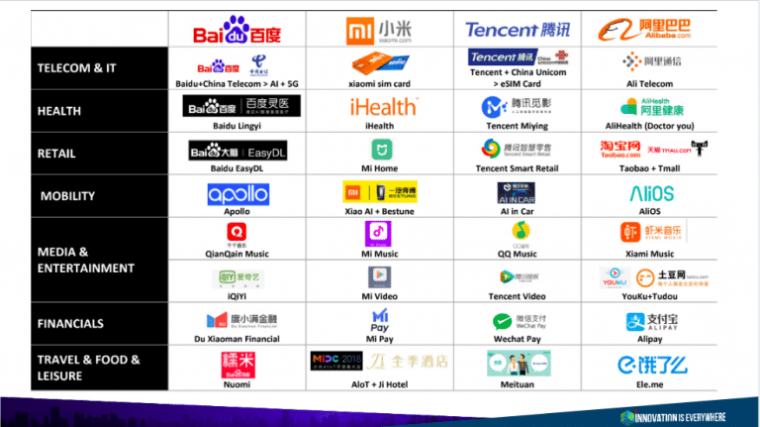
China “BATX” has status similar to, and competes with, GAFA in U.S.
Figure and quote from Delacharlerie, Celine. Mar. 2020. ”The Key Success Factors of Asian Companies’ Digital Transformation: BATX to Conquer All Industries.” Innovation is Everywhere <https://www.innovationiseverywhere.com/keys-to-success-asian-companies-digital-transformation/> accessed 2020.09.10

Slide 20
Digital-first, challenger banks in Asia
China | MyBank | 2015 by AliBaba | Focus: Consumers, SMEs. Uses data from AliPay for credit analysis
 | WeBank | 2015 by Tencent | First private, digital-only bank to launch in China
 | XW Bank | 2017 by Xiaomi | 24M customers. Provides open platform for other FinTech companies
 | AiBank | 2015 JV between China CITIC Bank & Baidu | Personal loans, deposit services, wallet systems, etc. Uses AI for risk optimization
Hong Kong | Neat | Not a bank but works with ePayLinks, a licensed stored value facility (SVF) | For unbanked entrepreneur community & SMEs. Provides multi-currency business accounts, personal accounts
Japan | Japan Net Bank (NJB) | 2000 by parent SMBC and NTT Docomo | Japan’s first Internet bank w/no branches
 | Rakuten Bank | 2001 by Rakuten
 | Jibun Bank | 2008 by MUFJ Bank & telecom KDDI
 | Kyash | 2015, startup | Still a payment app tied to a prepaid Visa card
S. Korea | KakaoBank | 2016, Korea Investment Holdings & Internet platform Kakao | 10M customers (July 2019)
 | K Bank | Consortium of 20 companies led by telecom KT Corp. | Korea’s first digital-only bank; uses big data from KT Corp. to offer loan terms
Info from FinTech News SG, 1/01/2020

Slide 21
More Asia challenger banks
Vietnam | Timo | 2015, startup | Mobile app. Works with partner VP Bank
India | InstantPay | 2013, startup, has raised INR 340M (US$5.3M) | For business and personal. Savings accounts, domestic money transfers, insurance, investment platform, quick loans
 | NiYO Solutions | 2015, startup, has raised US$49.2M | Salary account for blue-collar workers, global card for international travelers
 | OPEN | 2017, startup (has raised $37.4M) | For startups and SMEs; partners with ICICI Bank
 | Payzello | 2017, startup, seed stage | Comprehensive services; easy to set up account
 | YeloBank | 2019, startup | Services to manage daily cash flow; all-in-one card (credit, debit, foreign remittance); partners with ICICI Bank and Federal Bank
• Hong Kong began issuing virtual banking licenses in 3/2019. Eight granted by 2020, all still in testing.
• Singapore announced in 6/2019 that it would soon begin accepting virtual bank applications and grant up to five.
• Taiwan issued its first virtual banking licenses in 2020 to three banking consortia.
FinTech News Singapore, January 1, 2020 <https://fintechnews.sg/date/2020/01/>

Slide 22
NE Asia: Japan & South Korea have great potential, but are held back
To Right: Economist Intelligence Unit ranking of selected Asian countries on “Asian Digital Transformation Index”
Combination of ratings for digital infrastructure, human capital, industry connectivity
http://connectedfuture.economist.com/connecting-capabilities/wp-content/uploads/2016/11/Connecting-Capabilities_SOUTHKOREA_v6.pdf
But, Korea Industrial Technology Association 5/2020 survey of 49 major corps. & 1,296 smaller co’s:
Actively pursuing DX | 9.7%
Partially pursuing | 20.9
Will pursue in future | 21.8
Will not pursue | 36.8
Business Korea, June 16, 2020

Slide 23
NE Asia: Japan & Korea, continued
Japan: Government (METI) warned in mid-2018 that corporate sector is poised to fall off a “digital cliff” in 2025
Held back by legacy IT systems
When Microsoft stopped supporting Windows 7 (1/2020), 14M million computers were still using that operating system (government, companies, and households)
Reported in Financial Times, January 21, 2020
Why such problems?
Adoption of cloud-first architecture and conversion of legacy data records is required = extremely expensive
Legacy business processes go back to old-style quality standards (record keeping, use of official seals, etc.)
Both countries have active (new) entrants in consumer-facing digital industries
Rakuten, Mercari (Jp), Kakao (Kr)
Watch: very advanced technology development, smart factories, open innovation

Slide 24
SE Asia growth of digital economy is recent (since ~2015)
Consumer-driven (new middle class)
• Young, 96% have at least one mobile phone
Sidebar: Gojek versus Grab
• Started as ride-hailing
-- Gojek 2010 (Indonesia)
-- Grab 2012 (Singapore)
• Now provide multiple mobile services
• Reminiscent of competition between Alibaba & Tencent
• Lots of foreign investment as their success became obvious
Consumer-driven (new middle class)
• Young, mobile-first: 96% access the Internet via smartphone
Sidebar: Gojek versus Grab
• Started as ride-hailing
-- Gojek 2010 (Indonesia)
-- Grab 2012 (Singapore)
• Now provide multiple mobile services
• Reminiscent of competition between Alibaba & Tencent
• Similar situation with ecommerce Lazada vs Tokopedia
“e-Conomy SEA 2019 Report, Google / Temasek / Bain & Co https://www.blog.google/documents/47/SEA_Internet_Economy_Report_2019.pdf

Slide 25
SEA consumers are rapidly adopting online patterns
To Right:
% of survey respondents citing online as most frequently used shopping channel
• Survey by Facebook and Bain: 16,491 respondents in May 2020
“Digital Consumers of Tomorrow, Here Today.” Facebook and Bain & Company 2020 https://www.facebook.com/business/news/digital-consumers-of-tomorrow-here-today accessed 9/10/2020

Slide 26
Online spending translated into GMV
Online Retail Gross Market Value ($US)
“Digital Consumers of Tomorrow, Here Today.” Facebook and Bain & Company 2020 https://www.facebook.com/business/news/digital-consumers-of-tomorrow-here-today

Slide 27
India: rapid digitalization but uneven business adoption
Government initiatives: Digital India (2017)
Aadhaar biometric national ID program: largest in world
Most connected country after China
McKinsey Global Institute. Mar. 2019. Digital India https://www.mckinsey.com/~/media/mckinsey/business%20functions/mckinsey%20digital/our%20insights/digital%20india%20technology%20to%20transform%20a%20connected%20nation/digital-india-technology-to-transform-a-connected-nation-full-report.pdf

Slide 28
India: uneven approach to digital adoption by industry
 | ICT | Financial Services | Real Estate & Con-struction | Profes-sional Services | Education and Health | Manufac-turing | Transport
High Score | 71 | 57 | 66 | 74 | 63 | 73 | 53
Leaders (scored in top 25%) | 41% | 28% | 40% | 36% | 24% | 21% | 10%
Median Score | 50 | 48 | 47 | 47 | 46 | 45 | 43
Laggards | 26% | 17% | 15% | 20% | 29% | 27% | 19%
Low Score | 33 | 37 | 15 | 16 | 22 | 21 | 15
McKinsey Global Institute. Mar. 2019. Digital India https://www.mckinsey.com/~/media/mckinsey/business%20functions/mckinsey%20digital/our%20insights/digital%20india%20technology%20to%20transform%20a%20connected%20nation/digital-india-technology-to-transform-a-connected-nation-full-report.pdf

Slide 29
Summary for today
Digital transformation
Beyond adoption, “digital transformation” refers to change in a company’s core
Company’s response to macro-conditions of two simultaneous industrial revolutions
Accelerated by COVID-19
Asia
Driven by consumers
Gap between leaders and laggards
May see fastest growth in digitalization in entire world for next 10 years
Orally: introduction to some future sessions.

Slide 30
Thank you for participating!!
Contact: Richard Dasher, Ph.D. Director
rdasher@stanford.edu
Kimberley Williams
Assistant Director (interim)
kwillia1@stanford.edu

