Slide 1
Building the material movement pipeline of India
September 2021

Slide 2
Our Purpose
MAKING LOGISTICS HUMAN

Slide 3
Logistics and related commerce is a large market in India
Logistics market to grow to ~$770bn by 2025E
Logistics-Linked Digital Commerce Services to grow to ~$680bn by 2025E
Market Size ($ Bn)
Market Size ($ Bn)
⁽¹⁾
681
~2.2x
~2.7x
⁽¹⁾
249
Note:
Includes transportation and warehousing
Source: Industry research, SIAM, ACMA, Management estimates
Source: Industry Research, Management Estimates
Source: Armstrong & Associates, 2016 Transportation Industry Development Statistics Journal,National Bureau of Statistics, CapitalIQ, Department of Transportation of U.S.

Slide 4
Logistics Sector in India Faces several Challenges
Truck Drivers
~10 million
No social respect
Just 7-10 days spent at home in a month
No family life to speak of
Addiction to alcohol
Serious health, lifestyle challenges
Chronic truck driver shortage
Customers
Key Stakeholders
Fleet Suppliers
~20,000+ enterprises, 48 million MSMEs
~1.5 million
No visibility of consignments: Drudgery of 24x7 manual follow ups
“Everyday” hassle of finding demand impact peace of mind
Unreliable and unprofessional service
Low vehicle utilization (50-55%)
High long-haul transit time of average 4 - 5 days impacting business performance
Long and expensive working capital cycle
No price transparency
High level of intermediation leading to poor economics
No pricing benchmark
Only Data and Technology Can Solve This At Scale

Slide 5
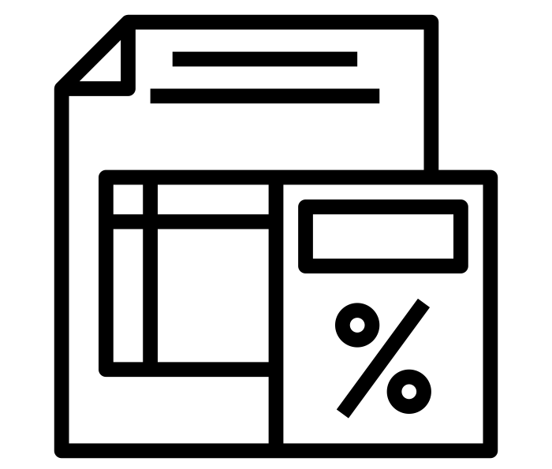
Landmark Reforms in recent times are beginning to have a meaningful impact on the sector
1
2
3
The Goods and Services Tax (GST)
Infrastructure Status for Logistics Sector
Digitization Push
Biggest Reform in history of Independent India
Easy access to funds at lower cost, longer tenure and enhanced limits
Digital E-Way Bill for every consignment
FASTag, Electronic Toll Collection for National Highways
What it means:
Web of Multiple Central and State taxes for Inter-State trading simplified
Inter-state movement of goods made seamless
Multiple entry barriers at states abolished
8
New Logistics division, headed by Special Secretary, set up in Ministry of Commerce to desgin an integrated National Logistics roadmap
Digital copies of vehicle documents
4
Step up in pace of building highways
Implications for India’s Supply Chain:
Rapid transit times now absolutely critical
Express Cargo movement to grow rapidly
Increased focus on reducing inventory in chain
Current many smaller warehouses to be replaced by ‘zero’captive warehouses and consolidated ‘3PL’facilities
Digitization and automation
Our economy is poised to grow up to $5 trillion in the next 7-8 years … Logistics will play the key role in driving this growth, it has always been the backbone of the economy. It determines how fast an economy grows…We are identifying hindrances and removing them…At the same time, we are trying to digitize the entire supply chain …”
--Commerce & Industry Minister,
83,000 km+ highway projects worth $100 billion+ to be built in next 5 years
Mega Bharatmala project: 50 national corridors planned vs 6 currently and 70 – 80% freight expected to move along National Highways vs 40% currently

Slide 6
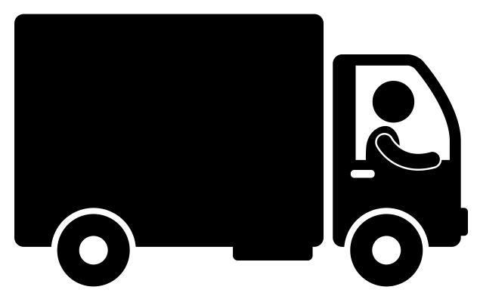
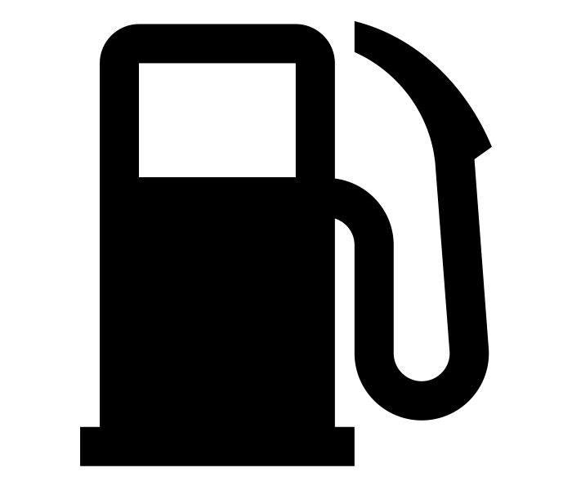
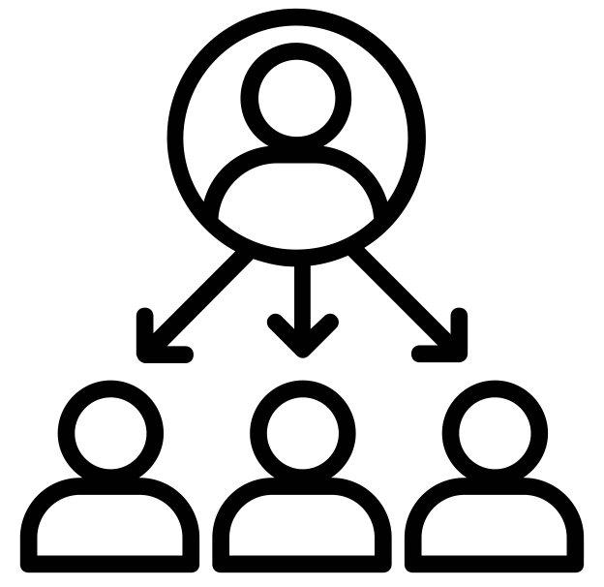
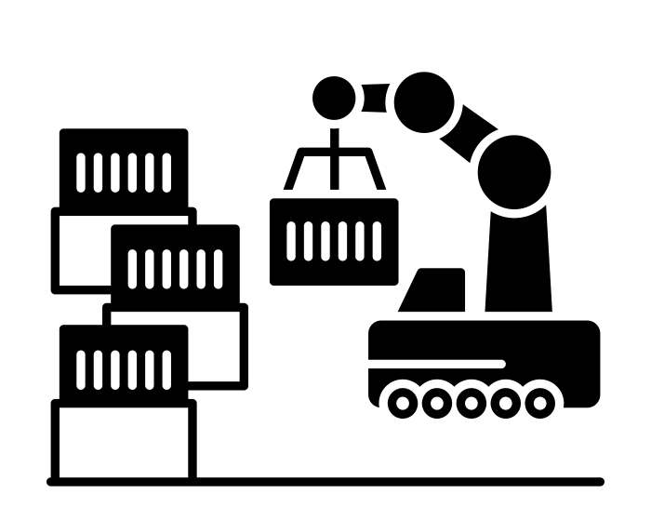
Rivigo is Creating a Ecosystem of Logistics and Related Commerce Services to Support the Growth of New India
RIVIGO’S UNIFIED LOGISTICS PLATFORM PRODUCTS AND DIGITAL COMMERCE SERVICES OVER TIME
MULTIPLE PARTICIPANTS
Customers
(Corporates, SMEs, Retail)
Fleet Financing
Supplier Credit
Fleet Suppliers
Fleet Insurance
Truck Services and Spares
Truck Drivers
Digital Toll Payments
Truck Sales
Brokers
Fuel
Relay As A Service
Channel Partners
Delivery Network Partner
(First and Last Mile)
RIVIGO’S UNIFIED LOGISTICS PLATFORM PRODUCTS
OEMs
k
Banks and NBFCs
Express Full Truck Load
Express Cargo
Cold Chain
Freight Brokerage
3PL Warehousing
Insurance Providers
Oil Marketing Companies

Slide 7
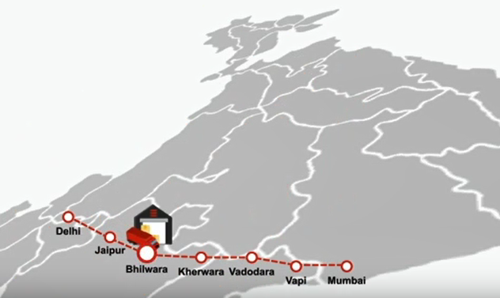
Rivigo Relay: Globally Unique Operating Model Innovation Changing the Face of Logistics and Transportation
Rivigo Relay Model Explained: Video
Delhi
Mumbai
Pit-stops
Pilot to pilot changeover at every pitstop
Pilots rostered back to home base
Minimal downtime for vehicles
Lean operations at each pitstop
V1, D1
V1, D2
V1, D3
V1, D4
V1, D5
V1, D6
100% automation and tech driven processes
Delhi
Jaipur
Bhilwara
Kherwara
Vadodara
Vapi
Mumbai
V2, D1
V2, D2
V2, D3
V2, D4
V2, D5
V2, D6
Driver returns home every day
Vehicle runs upto 22-23 hours a day
V: Vehicle
D: Driver
50% - 70% reduced transit time, ~4x Safer than Industry, 2x – 3x higher Asset Utilization

Slide 8
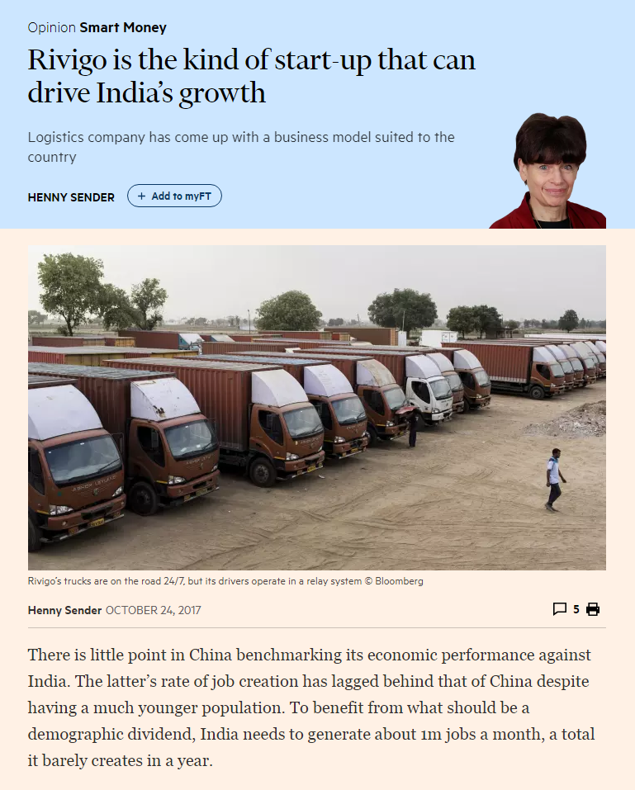
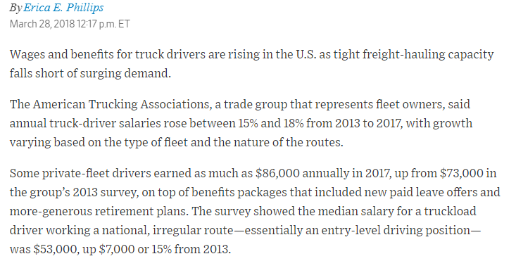
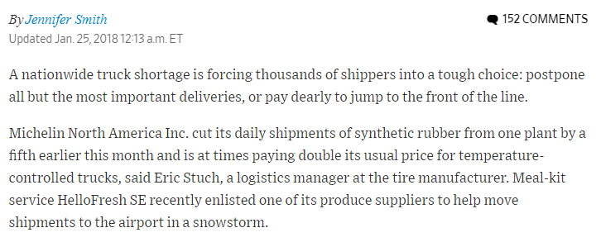
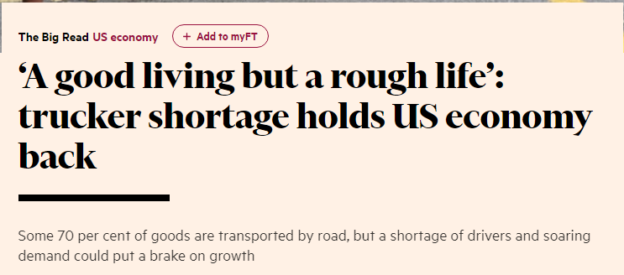
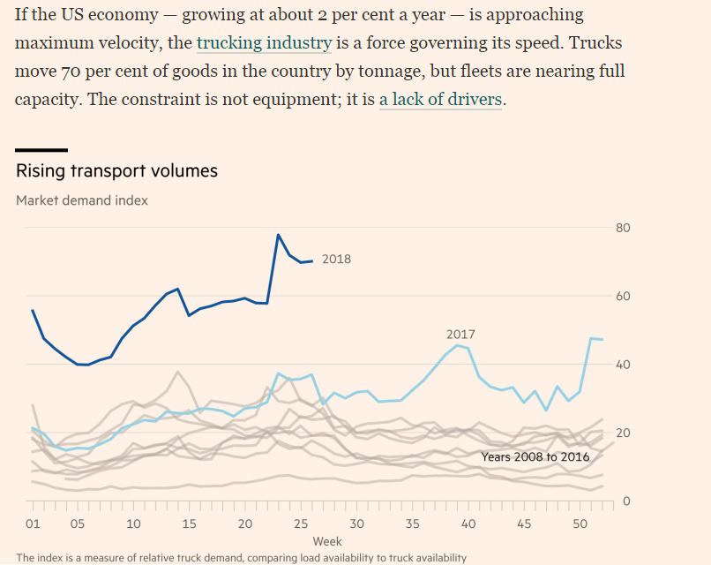
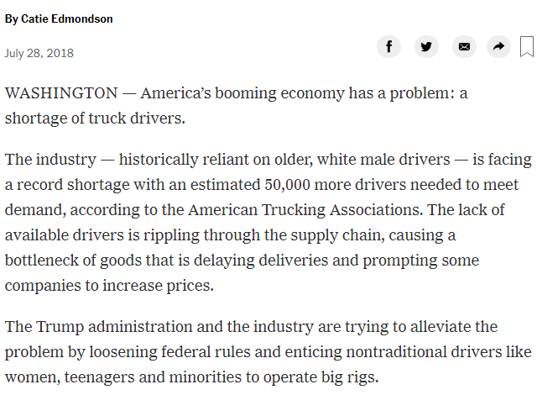
Truck driver shortage is a global problem
Truck Driver Shortage is a Global Problem
Recognition of Rivigo’s Innovation

Slide 9
Data and technology is at the core of our work
Supplier Digital Profile
Machine Learning
Freight Rates
Massive Data
Material Movement Data
Artificial Intelligence
Consignment Continuum
Heuristic Inputs
Vehicle IoT Ecosystem – Temperature, Fuel, Engine, Tyre
More data leads to better intelligence
Vehicle Continuum
Data Sciences
Pilot Continuum
Enhanced human impact drives higher adoption, leading to richer and deeper data
Better intelligence creates better products
Making Logistics Human
Disruptive Tech Products
Freight Rate Exchange
Supplier Quality Engine
Truck Pilots
Network Planner & Optimizer
Better products leads to enhanced human impact
Consignment Auto Allocator
Fleet Suppliers
Advanced Relay Allocation System
Temperature Integrity
Management
Fuel Efficiency Optimizer
Customers

Slide 10
We have Massive, Unique Datasets Leading to Unparalleled Intelligence
Vehicle Continuum
Vehicle location data captured every second for each Rivigo truck across full fleet since 2014. Data pushed every second to the cloud for real time analysis and business intelligence
Temperature Data
Temperature of the reefer unit for cold chain truck fleet captured and pushed every minute to cloud, to build two way communication with auto monitoring and remote temperature control based on profile of the material being transported
Pilot Continuum
Material Movement Data
AI
Technology
Pilot location data and Pilot app user journey captured per minute for all Rivigo pilots. Data pushed every minute to the cloud for real time analysis and business intelligence
Daily demand data for freight and inventory information of trucks across India from 20K+ demand users and 50K+ supply users. 250K+ loads and 1 MM+ truck inventory data. Event level push every second
Consignment Continuum
Processed Camera Feed⁽¹⁾
1,437 micro actions for each consignment handled from pick up to delivery tracked. 1 billion + events data captured worth 2 TB. Event level push every second
Vehicle Vitals
Outward and inward facing processed camera feed planned for full relay fleet - Will capture data on ~400Million+ kilometers per year
IoT sensors and telematics capture engine state, RPM, battery voltage, oil pressure and temperature, tyre pressure and temperature for all Rivigo fleet. Data captured every second and pushed to cloud
Freight Rates
Origin – Destination –Vehicle Type level freight prices collection from over 70K users. 400K + crowd sourced fright rates and 100K+ trip data. Event level push every second
Supplier Digital Profile Data
Fuel Data
300 + digital markers of each supplier on Freight Brokerage platform gathered, 100 MM+ events captured. Data pushed every 2 hours
Fuel level in tank for each truck captured for all Rivigo fleet. Data captured and pushed to cloud every 30 seconds. Extreme smoothening capabilities applied on data as value of fuel changes due to running and movement on highways
Machine Learning
Data related to ~500 million kilometers captured till date
Only Company to have rich data on complete material movement chain of India
Invaluable for building our Digital Commerce Services
Note:
Being rolled out over the full Relay fleet

Slide 11
Technology Drives Every Aspect of Our Complex Operations
Freight Pricing Engine
ETA Predictor
Supply Demand Matching Engine
Fuel Mileage Optimizer
Pricing engine capable of predicting price from anywhere to anywhere in India for all truck types
Machine learning algorithms to predict price movements using historical and real time Rivigo data points captured -user activities, crowd sourced prices, actual live transactions in the market place, time spent on monitoring price
Multitude of factors incorporated - distance, material type and weight, vehicle type, annual demand, seasonality, cyclicality etc.
Operating at less than 0.5% median deviation from the actual market transaction rates for liquid lanes
Proprietary ETA micro service to predict truck movement on Indian highways completely developed in-house using historical Rivigo data
Multiple machine learning models to predict travel times based on the various factors like time of the day, day of the week for anywhere to anywhere in Indian highways, predict wait times at tolls, borders and client warehouses to provide real-time prediction of arrival times of trucks in the network
Better accuracy than Google Maps which primarily maps passenger vehicle movement
Predicts the quality of supply user using the digital markers
300+ digital markers captured for every supplier and uses self learning supervised algorithms to predict the user quality score
This quality score based matching is used to match the demand and supply in the marketplace
Regression based models built to measure the significance of driving parameters on Fuel Mileage
20+ parameters being captured currently including driving behavior, vehicle state, truck load, client profile, pilot profile and environment at all conditions which are used for regression
Pilot-level personalized feedback given based on performance against each input driving parameters to improve the mileage efficiency
Machine Learning
Pilot Resource Planner
Pilot Allocation Engine
Fuel Pilferage Control
Heuristic based approach to minimize the number of pilots required by pitstops to meet the sales plan and improve pilot lifestyle (returning home < 12 hours)
Algorithm simulates the whole network for the given sales forecast and reproduces the stochasticity of each variable in the network to calculate the optimal pilot requirement
Enables us to operate with minimum number of pilots and maximum pilot utilization
Allocation Engine to assign optimal pilot to vehicle trips
Heuristic based allocator optimizes for FIFO of pilot duties, real time pilot availability and pilot behaviour in terms of duty acceptance
Scalable engine which makes it possible to assign 6,000+ pilots every day to moving vehicles all over India
Intelligent algorithm to eliminate fuel pilferage incidents
Rule based algorithms to detect fuel pilferage events in real-time based on learnings from 100+ real use cases scenarios and leveraging IoT sensors
Heuristics
Relay Fulfilment Engine
Network Planner and Optimizer
Data Sciences
Intelligent CRM decides how many indents expected from contracted clients based on news vendor model and suggests how many indents to take from market
Dynamic programming based approach to minimize network imbalance based on demand variability and decide on which indents to serve
Linear programming based Hungarian algorithm engine for vehicle allocation for selected indents and matching algorithm based on partitioning, reachability, proximity, due for maintenance, and proximity to maintenance hubs
Helps optimize movement of consignments within the Network with optimal transshipments while meeting the promised TAT
Leverages Integer programming and optimizes network design with balanced cost and timely delivery and it also runs a allocation engine to determine which Consignment should go to which vehicle in the given network to ensure the utilization of vehicles

Slide 12
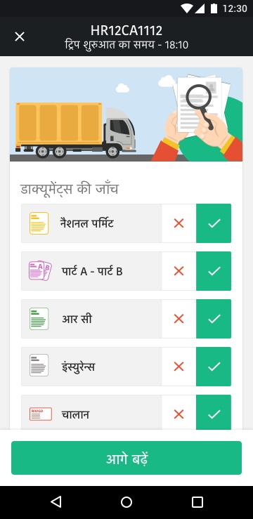
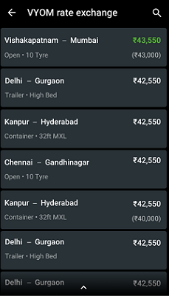
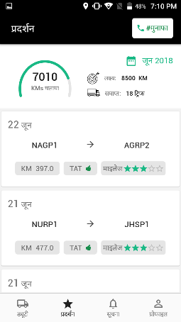
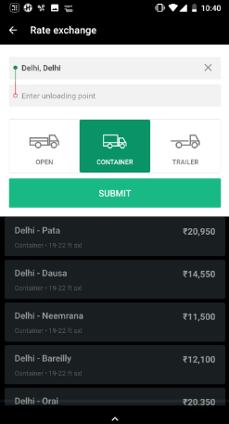
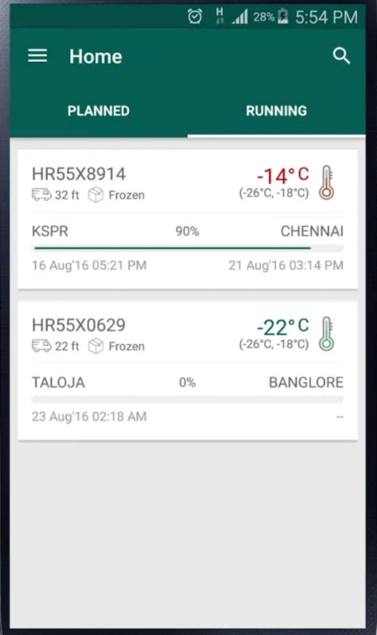
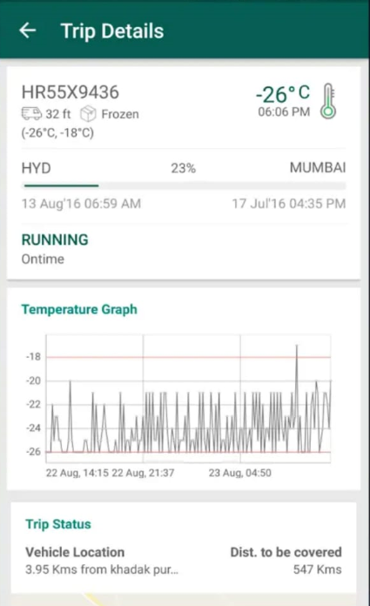
Breakthrough Tech Products Power Every Element of Our Operations
Pilot App
Freight Rate Exchange
QR code based Pilot-to-Pilot changeover eliminates human intervention and makes Relay scalable
Brings price transparency across 1 million+ lanes, establishes trust with fleet suppliers
Seeks input on every trip, makes pilot accountable for vehicle assets, documents and vehicle health
Defining market prices accurately creates a pull for supply network, enabling faster platform growth
Engages Pilots with active feedback or kilometers driven, mileage, Turn Around Time (TAT) performance and more
Rate exchange introduces digital behavior in fleet supplier, digitizes freight
Shares real-time visibility on payout details and incentives
Data models on Consignment Note (CN) for Operations
Live tracking with temperature integrity
Enables Express Cargo to achieve ‘perfect delivery’ – on time, in full, at lowest cost - every time
Real-time visibility of consignment and trip tracking along with temperature control
Real Time Operations Associate Performance Score Card to ensure highest executional performance on ground
Temperature control in the hands of the customer through two way IoT sensors
Vehicle Load Planner auto plans CNs to be loaded on each trip, maximizes vehicle utilization and profitability
Unified platform for order, payments and performance
Network Planner optimizes network design to balance cost and timely delivery
E-invoicing with digital proof of delivery
Damage & Pilferage Predictor suggests loading position in vehicle, enforcing stricter quality control
Performance snapshot

Slide 13
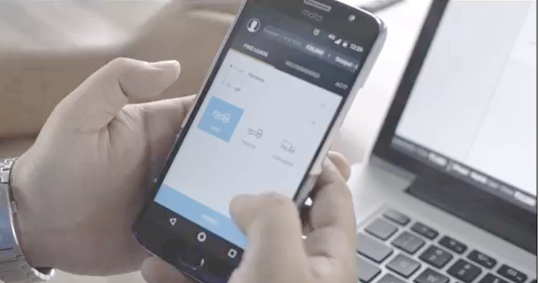
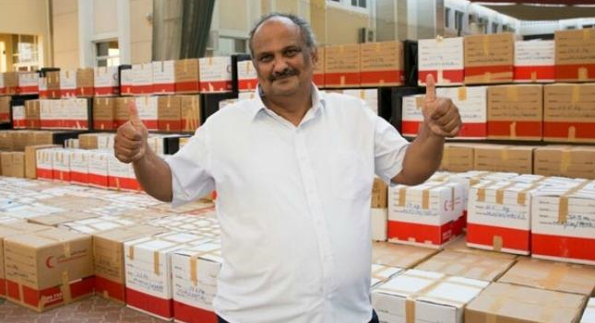
We Believe only Technology can Make Logistics Human
Pilots
Fleet Suppliers
Customers
“From 37th Caste to Nation's New Army”
“From Survival to Abundance”
”From drudgery of unreliable operations to celebrating growth”
Bringing truck pilots mainstream. From being the outcast in the society to now getting respected as a key enabler of India's economic warfare
Ease of finding demand - From 100 calls a day to less than 6 clicks on the app
Supply chain head gets the attention of CEO and CFO. Being celebrated for driving improvement in business with new age logistics - fast, reliable and digital - resulting in sales growth, unlocking cash flow, reduction in total supply chain costs
Feel a sense of pride as a 'Rivigo Truck Pilot' - Has a family life, does not live on the road in the truck, gets payments on time and is connected to technology through his Pilot app
Hassle-free operations - Timely advance from shipper, cash less disbursement of trip expense to driver for toll, diesel, follow up for Proof of Delivery for billing and remainder payment - are all now seamlessly done digitally through an app
Happier supply chain teams - Real time visibility and information on fleet removes drudgery of 24x7 manual follow ups, logistics staff can now spend more time with their families at home and not be on the phone continuously
From being away from family for days to now being there for his parents, wives and children each day, in good times and bad
Trust in pricing - Access to highly accurate Rivigo Freight Rates brings peace of mind; no more blackmail by intermediaries and brokers
Truck drivers' wives have gone from living in the constant fear of road accidents, to now having peace of mind as relay driving ensures much higher safety levels, mandatory rest between driving duties
Get back home for dinner as no extra shifts or late night after hours at warehouse waiting for pick ups to finish or deliveries to happen. On time, every time enables better lifestyles
Flexibility - From running a physical outpost in the trucking micro-markets to now running business to run entire on Freight Mobile app, anytime, anywhere
Hassle-free operations - Streamlined controls and audit processes (with online POD), real-time operational performance, dashboards and insights, transparent billing processes (e-invoicing, online reconciliation and payment options) all lead to ease of doing work by reducing manual efforts
From skipping meals and eating unhealthy food at street side on the highways, to now eating home-cooked food and having access to health insurance. Leading healthier and more balanced lifestyles with more savings
Opportunity to grow business through digital commerce services – Direct cost savings on fuel, toll and more, as well as ease of managing faraway fleet from home base

Slide 14
Rivigo’s Value Proposition for Customers, Across Industries, Leading to Strong Customer Pull for Our Services
Rivigo’s Exceptional Service Promise
Clear Value Delivered for Customers
Leading to Customers Re-imagining Their Supply Chain
Nationwide, end-to-end service
Unprecedented transit time by road
50-70% lower vs industry
Rivigo Relay reduced transit time by 50% thereby solving month end stock outs and resulting in increased sales
10%
Month end sales
Reduction in total logistics cost
Relay Full Truck Load solved for heavy losses due to engine movements delays and large working capital by reducing transit time by 2 days and transit inventory by 40%
Reduced need to rely on air and rail shipment
Lowest in Industry Damage and Pilferage
144 ppm⁽¹⁾ vs. industry average of 1000 ppm
0
Production losses due to delay
Post GST, Rivigo’s Relay model significantly reduced number of warehouses enabling direct delivery from factory to dealer. Also reduced safety norm inventory by 60%
Faster availability of products in market
88%
Reduction in number of warehouses (from 8 to 1)
Each parcel handled like “Own” parcel
Digitized
Live tracking, alerts, and much more
Through a combination of Rivigo Unified Logistics Platform products, reduced transit time from factory to dealer by 55%, freeing up capital sooner
Access to disruptive tech products
>6%
Dealer ROI
Note:
Parts Per Million

Slide 15
Deep-rooted Culture to Build an Institution for Long Term
Our Core Beliefs
Manifested in our actions and behaviors as 10 Rivigo Leadership Principles
We believe organization culture (how things get done here) is the biggest determinant of long term success. We can only under invest in building a great culture
RIVIGO LEADERSHIP PRINCIPLES
OWNERSHIP
I am an owner. Not an employee.
I act on behalf of the entire company.
We put an unusual effort in hiring exceptional people for every role. We raise the bar with each hire
HIRE BETTER
PEOPLE
I hire people better than myself.
I mentor and coach to make them better.
TECHNOLOGY
OBSESSION
I use technology to solve problems.
I always ask how technology can bring efficiency or reduce effort in whatever I do.
We are purposeful in everything we do. Our hiring, celebrations, engineering and business goals are aligned towards the purpose of making logistics human.
DATA DRIVEN
I like to get into depth. I like to measure everything through numbers and believe it is the only source of truth.
We are obsessed about right inputs. Only consistent right inputs over long term lead to mega and magical outcomes
BOUNDLESS
ENERGY
I deeply connect with my source of energy every day and bring that energy to everything I do in life.
THINK BIG
I think big. I think bold. I don't say no to challenges and don't fear failures.
We operate from a deep sense of purity and righteousness. We will never take short cuts in anything we do
1% IMPROVEMENT
EVERYDAY
I constantly better myself and my work every day.
I believe in learning from mistakes to ensure I do not repeat them.
We believe pace is key to all accomplishments. Right pace comes with clarity and concentration and not with hustle
RESPECTFULLY
DISAGREE & COMMIT
I respectfully challenge the decisions of my team members when I have a better solution.
FRUGALITY
I am sensitive to wastage and inefficiency.
I don't overspend. I am resourceful.
We celebrate people who are egoless and humble. It ensures that we or our short term success does not come in the way of building a long term scalable institution
SAY/DO= 100%
I do what I say. Not less. It helps me build a cycle of trust with everyone around me.
And further Strengthened through the two moments of truth – ‘Who we let in’ and ‘Who we celebrate’
Hiring Heroes
We follow rigorous process to look for people who are driven by our purpose, align to our leadership principles and raise our collective bar
People Development Reviews
We don’t rate or box people, but instead really focus on their true unlock. We celebrate Hero’s Journeys. If we don’t see alignment to our purpose or RLPs (marker for the individual’s long-term scalability at Rivigo), we let go

Slide 16
We have invested heavily in building a strong team and a culture of excellence
We Put an “Unusual Effort” in Building a Strong Foundation of Exceptional Talent and Deep Rooted Culture
A purposeful mission and a set of shared beliefs
The Ten Rivigo leadership principles (RLPs) define our ‘way of life’ and come alive through deep manifestation mechanisms. RLPs govern every decision and action at RIVIGO
RLPs embedded further through the two critical moments of truth (who we let in and who we celebrate):
Hiring: We hire not for skills, but for an individual’s scalability and likelihood to succeed at RIVIGO in the long-term. This is why our hiring assessments and decisions are based on the RLPs alone
Performance management: Our personal development and rewards philosophy over-indexes on long-term scalability in RIVIGO’s context and is hence based on alignment to RLPs
“Hero’s Journey” experiences help create self-awareness in individuals and help them become the best version of themselves
“Servant leaders’ who nurture people and build them up through on the ground engagement and mentorship
Deep investment in each individual through unique Rivigo masteries, where role specific skills, tools, practices are imparted to get them to peak performance in their roles
Building an Institution for the Future
Leadership
Technology
Operations
Sales, marketing and distribution
A committed senior team of 20+ exceptional and inspiring servant leaders who are driven by our vision, operate from a deep sense of purpose and with humility
Diverse, highly relevant prior experience across operations, technology, consulting, B2B and e-commerce viz. McKinsey, ITC, BCG, Airtel, Amazon, Microsoft, Adobe
Each leader has attracted top talent from the industry and built inspired teams that are driven by RIVIGO’s purpose.
Scaling up vertically by achieving a higher level of self-awareness through Hero’s Journey, inspired to take on bold challenges
300+ team solving futuristic never-done-before problems
AI effort led by eminent professor at Carnegie Melon University, US
Engineering leaders and product managers from top global product companies viz. Adobe, Google, InMobi, Microsoft
Only startup to be a “Day zero” employer at top engineering schools (hired 25+ top rankers from IITs in 2017)
Deep investment in capability building through world-class mastery programs on advanced Java, Data and Architecture,
3,000+ team with 40+ cluster and regional leaders in 130+ locations
Cluster and regional leaders with prior experience leading operations at large companies viz. ITC, HUL, Amazon, Schlumberger, Asian Paints, PepsiCo etc.
Continuous capability building for field staff/frontline through dedicated ‘Mastery Academies’ for imparting necessary skills, tools and practices
400+ salesforce for corporates, enterprise customers and network partners across locations
300+ sales and distribution team for freight brokerage across 208+ micro markets
Cluster and regional business managers and national account managers with prior experience of leading sales for large companies like HUL, P&G, Airtel, Vodafone
Focus on continuous development through flagship Mastery Programs like the ‘Impact Leadership Academy’ for building capability, connect and clarity in salesforce

Slide 17
Express Logistics: Extensive and Reliable 24 X 7 Pan India Relay Network on All Key Routes and Expanding
Mother Pitstops
Processing Centers
70
Highway Truck Pit stops
16,000+
Pin Codes
Pitstops with 24x7 technician
Chandigarh
Branches
Amritsar
Baddi
Jalandhar
Ludhiana
Ambala
Azadpur; Asaf Ali
Bamnoli; Okhla
Gazipur; Faridabad
Gurgaon; Rohtak
Sonepat; Kirtinagar
Peeragarhi; Neemrana
Alwar
Zirakpur
Karnal
Ghaziabad; Noida
Haridwar; Dehradun
Rudrapur; Meerut
Moradabad
Delhi
Noida
Jodhpur
Agra
Lucknow
Gorakhpur
Siliguri
Guwahati
Udaipur
Jaipur
Kanpur
Allahabad
Patna
Muzaffarpur
Guwahati
Bhilwara
Varanasi
Aurangabad
200+
Cities
470+
Delivery Network Partners for first and last mile
Vadodara
Kherwara
Jhansi
Jamnagar
Indore
Bhopal
Jabalpur
Ranchi
Dhanbad
Kolkata
Ahmedabad
Pitampur
Narsinghpur
Jamshedpur
Bhiwandi
Mumbai West
Bhandup
Raey road
Vasai
Navi Mumbai
Tarapur
Surat
Vapi
Dhule
Malkapur
Balasore
Shyam Bazar
Taratala
Kolkata City
Bhiwandi
Nanded
Adilabad
Bhubaneshwar
Pune
Berhampur
Sholapur
Uppal
Visakhapatnam
Nagpur; Pune City
Chakan; Wagholi
Aurangabad
Raipur; Goa
Nasik; Hinjewadi
Hyderabad
Vijayawada
Belgaum
Ongole
Kudlu gate
Whitefield
Richmond circle
Jigani
2 Million+
Sq. Ft Processing Center Capacity
~30 Million
Kilometers runs per month
Hubli
Chitradurga
Hassan
Chennai
Bangalore
Mysore
Salem
Pondicherry
Chennai Central
Chennai North
Reliance Branch
Coimbatore
Tiruppur
Trichy
Madurai
We Have Mapped the Entire Country: East to West, North to South
Proven, Single Network Backbone for Full Truck Load, Express Cargo and Cold Chain Services

Slide 18
Our Unbeatable Competitive Edge
1
2
3
We are “Pilot” First
Game changing Industry Partnerships
Deep Rooted Engineering and Tech Culture
4
5
6
Disruptive Data Intelligence Driven Tech Products
Extensive Masteries
Purposeful and Inputs Driven Organization Culture
7
8
9
✓
Unflinching Customer Trust
Unique Network Design
Structurally Reengineering Industry's Cost Structure

Slide 19
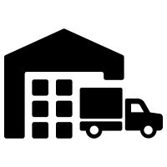
Rivigo of 2027
Largest Express Logistics company in India
India’s Largest and De facto Freight Brokerage (Relay as a service)
India’s Leading 3PL Warehousing Player
India’s Largest CV and Supplier Financing Platform
India’s Largest Insurance Platform for Commercial Vehicles
India’s Largest Truck Sales Platform
India’s Largest Organized Maintenance and Spares Services Network
India’s Largest Fuel and Toll Payments Enabler

